Slide 1
Analyzing Startup Trends in 2022
A Review of Key Trends Shaping the Startup Landscape
-Mridula MB

Slide 2
Navigating the Innovation Landscape: Startup Trends in 2022
As the global economy continues to evolve, startups are at the forefront of innovation, driving change across industries.
Our focus will be on key metrics, including the top-earning companies, predominant sectors attracting investments, the distribution of funding across different stages, monthly variations in funding activity, and the most influential investors shaping the financial landscape.

Slide 3
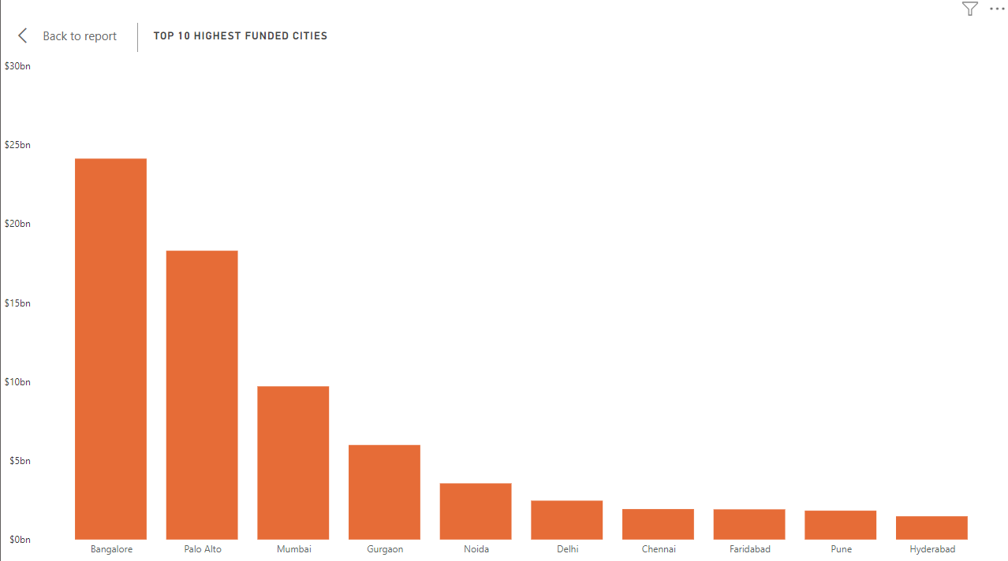
Top 10 Highest Funded Cities

Slide 4
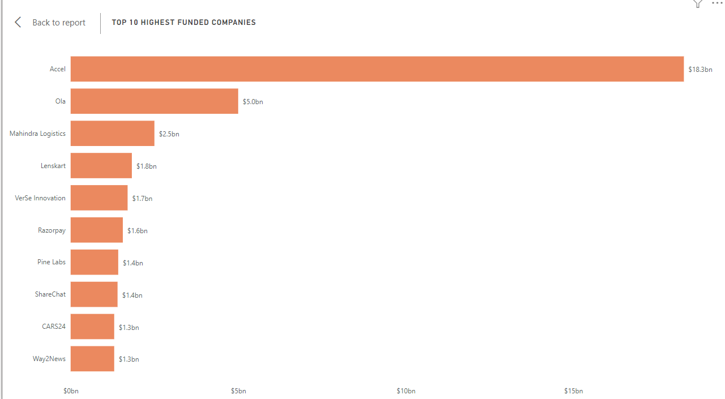
Top 10 Highest Funded Companies

Slide 5
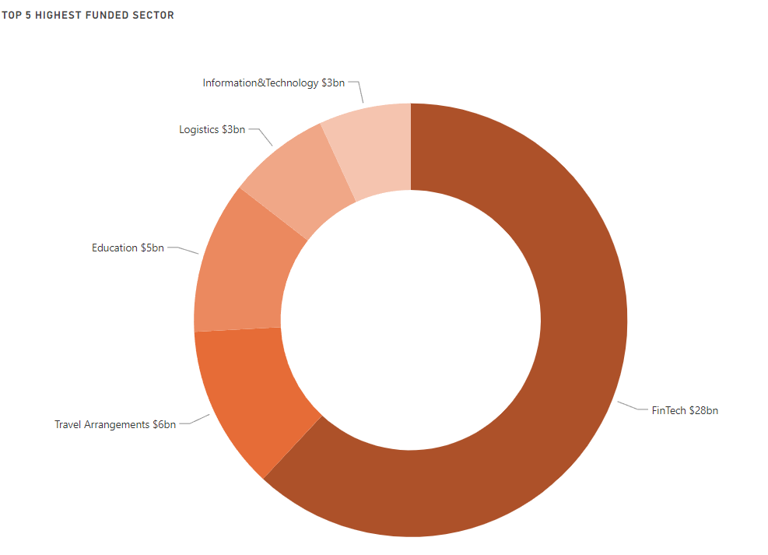
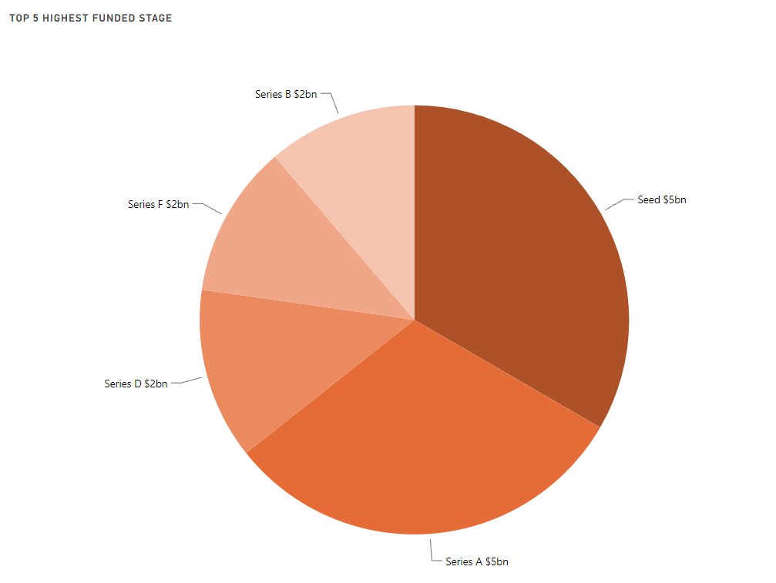
Top 5 Highest Funded Sector and the Stage

Slide 6
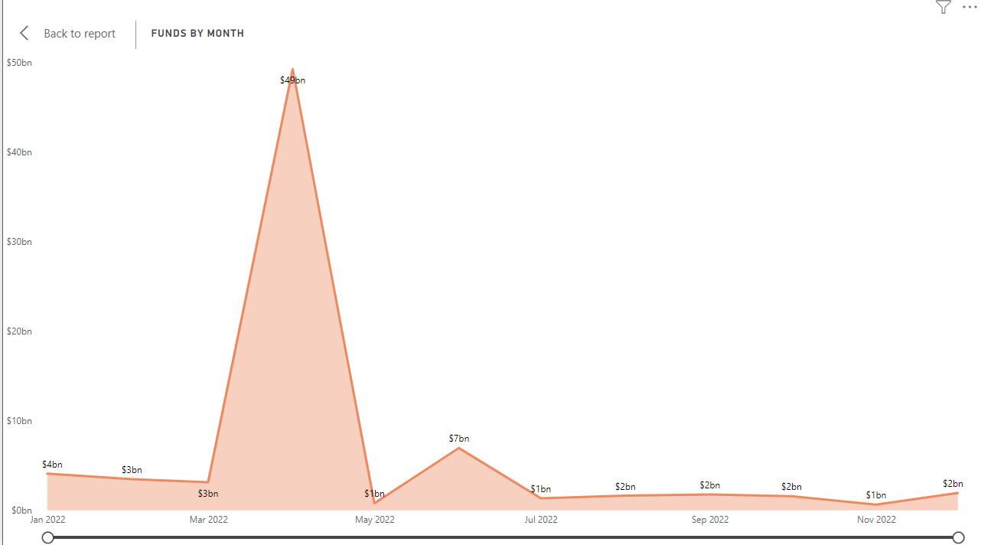
Funds by Months

Slide 7
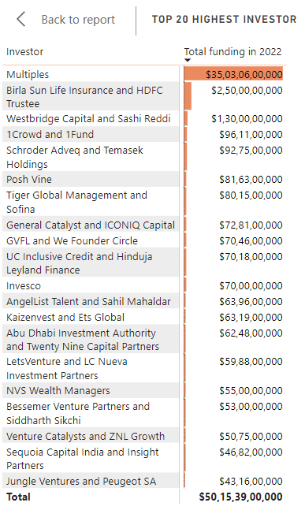
Top 20 Investors in 2022

Slide 8
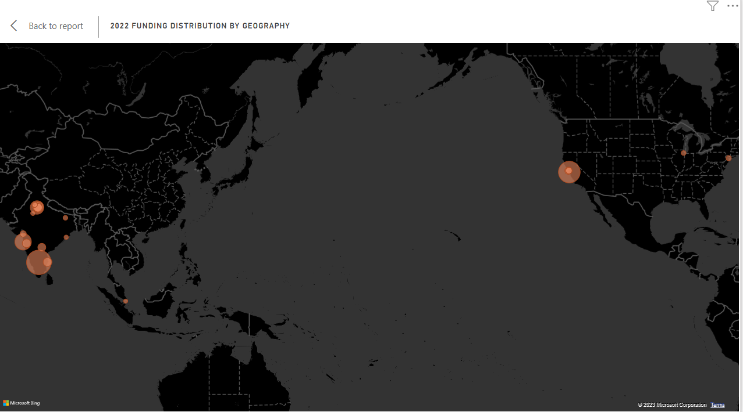
2022 Funding Distribution by Geography

Slide 9
Conclusions
Bangalore as a Startup Hub: Bangalore solidified its position as a thriving startup hub, with a surge in funding activities. The city's ecosystem continued to foster innovation and draw attention from investors globally.
Highest-Funded Companies: Examining the details of the highest-funded companies uncovered notable success stories. These companies demonstrated the ability to secure substantial investments, often due to disruptive technologies or innovative business models.
Fintech Dominance: Fintech emerged as a standout sector, witnessing substantial growth in funding throughout 2022. The sector showcased resilience and innovation, attracting significant investor interest.

Slide 10
Conclusions
Diverse Funding Stages: The funding landscape exhibited diversity across different stages, emphasizing the importance of early-stage support and late-stage scaling. Year 2022 marked a distinct preference for Seed and Series Funding, highlighting a collective focus on supporting startups at their initial and subsequent growth phases.
Monthly Funding Dynamics: Analysis of funding by month revealed distinct patterns and fluctuations throughout the year. Peaks and troughs provided insights into the dynamic nature of investor sentiments and market trends.
Investors Impact: The influence of the investors in shaping the startup landscape was undeniable. Their strategic investments contributed significantly to the success of various ventures across diverse sectors.

Slide 11
Resources used to get the data
https://startuptalky.com/indian-startups-funding-investors-data-2022/#Indian_Startups_Funding_Data_-_January_2022
In this extensive research, many companies in this analysis have opted not to publicly disclose comprehensive funding details, including specific amounts, stages, and investor identities. Non-disclosure is common, especially among early-stage firms or those not subject to regulatory reporting.

Slide 12
Thank you!

